Slide 1

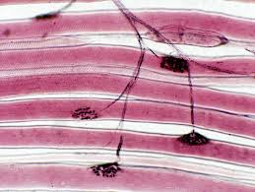
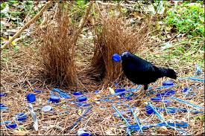
Information Flow in Biological Systems
Hayat الحياة‎
Andy Berg, Buzz Hoagland, Diane Genereux, Stephanie Moeckel-Cole, Karen Riska, and Ludmila Tyler

Slide 2
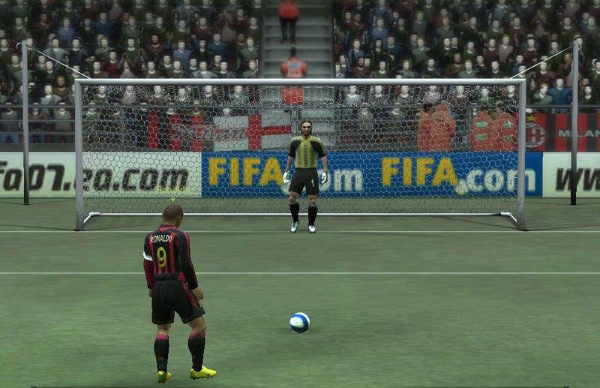
Hybridized concept map /strip sequence
Foundational activity to explore the conceptual framework of information flow in biological systems
  Adaptable for increasing levels of complexity
3 levels:
  intra-cellular
  inter-cellular
  inter-individual

Slide 3
We should be able to:
Organize general biological concepts into a framework and provide concrete examples.
Articulate how biological pathways integrate signals, receptors, and responses.
Identify similar principles of information flow on different levels of biological organization.

Slide 4
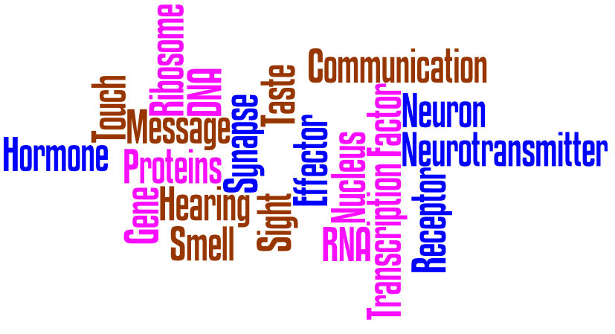

Slide 6

To what extent do you agree with the following statement?
We organized general biological concepts into a framework and provide concrete examples.
A. strongly agree
somewhat agree
C. neither agree nor disagree
D. somewhat disagree
E. strongly disagree

Slide 7
To what extent do you agree with the following statement?
We articulated how biological pathways integrate signals, receptors, and responses.
A. strongly agree
somewhat agree
C. neither agree nor disagree
D. somewhat disagree
E. strongly disagree

Slide 8
To what extent do you agree with the following statement?
We identified similar principles of information flow on different levels of biological organization.
A. strongly agree
somewhat agree
C. neither agree nor disagree
D. somewhat disagree
E. strongly disagree

Slide 10
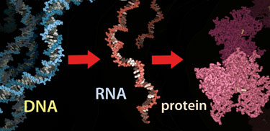
We:
Organized general biological concepts into a framework and provide concrete examples.
Articulated how biological pathways integrate signals, receptors, and responses.
Identified similar principles of information flow on different levels of biological organization.

Slide 12
Response occurs.
Your choice.
Signal is transmitted.
Response modulates signaling.
Stimulus triggers a signal.
Signal is perceived.
Signals are integrated leading to a response.
Information is stored.

